Slide 1

Parametric Probability Distributions and Committor Functions
Nils Strand
August 8, 2024

Slide 2
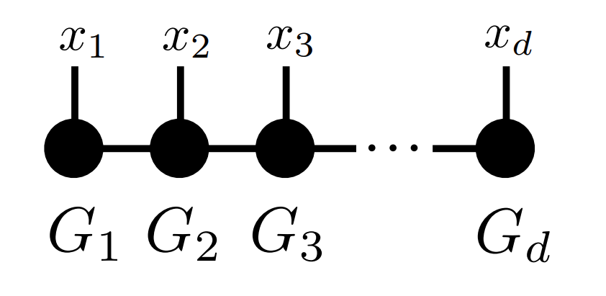
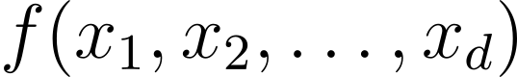
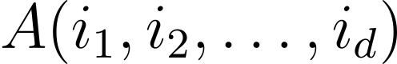
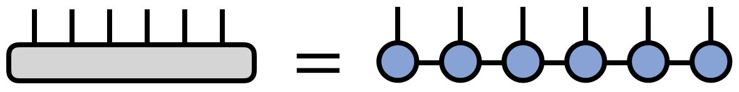
High-dimensional interpolating functions
How can one compactly store a high-dimensional function using only a few function evaluations?
One possible solution: tensor networks!
Rank r << n^d

Slide 3
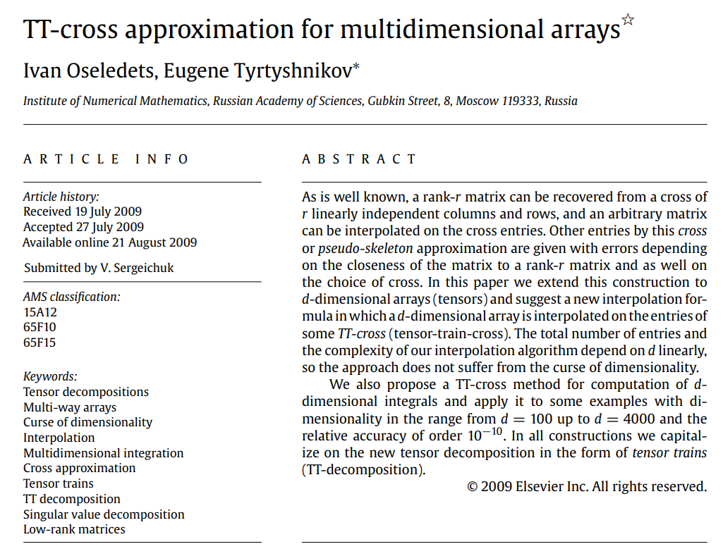

Slide 4
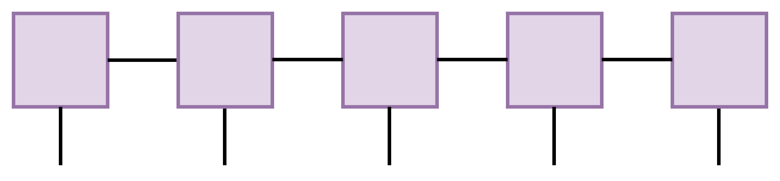
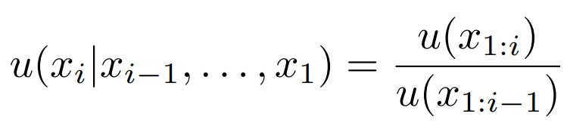
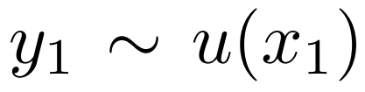
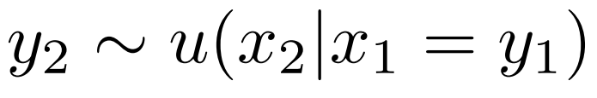
What can we do with TT-cross approximation?
Multidimensional integrals (partition function, moments)
Sampling multidimensional distribution (“generative modeling”)
Univariate integration!
Y. Chen and Y. Khoo 2023 arXiv:2305

Slide 5
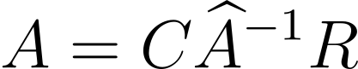
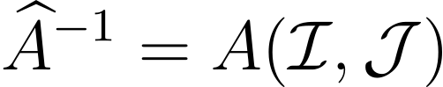
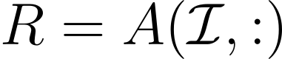
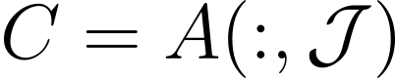
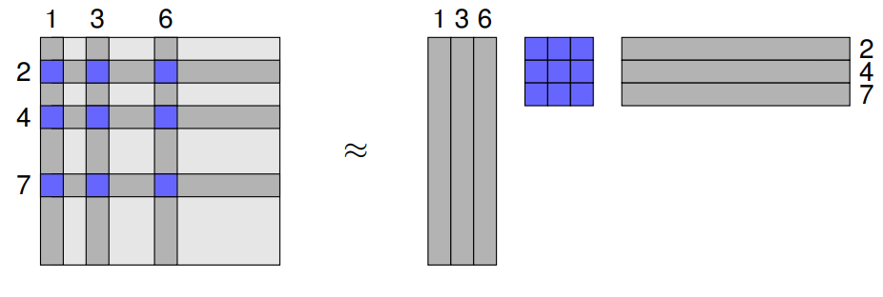
Cross approximation for matrices
“Skeleton decomposition”
r x r matrix

Slide 6
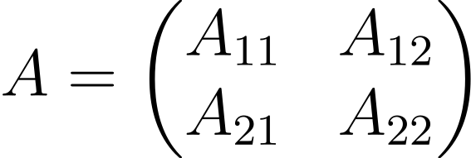
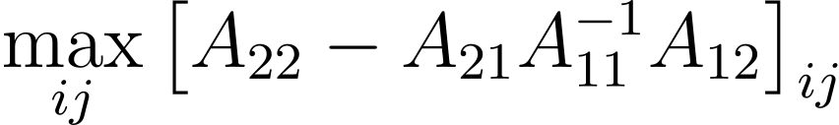
Cross approximation for matrices
First tensor core in TT
How can we efficiently construct a good r x r submatrix?
Optimal solution NP-hard problem
Adaptive cross approximation (ACA)
Iteratively finds “maximal volume” submatrix (greedy algorithm)

Slide 7
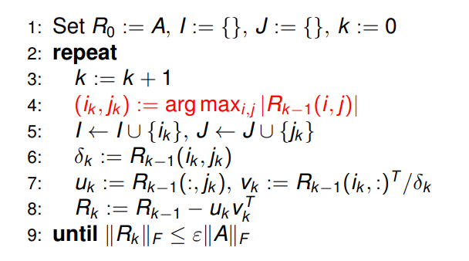
Adaptive cross approximation
This step is expensive!
Can we apply importance sampling (e.g. MCMC) to this step?

Slide 8

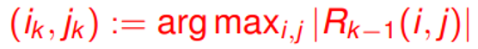
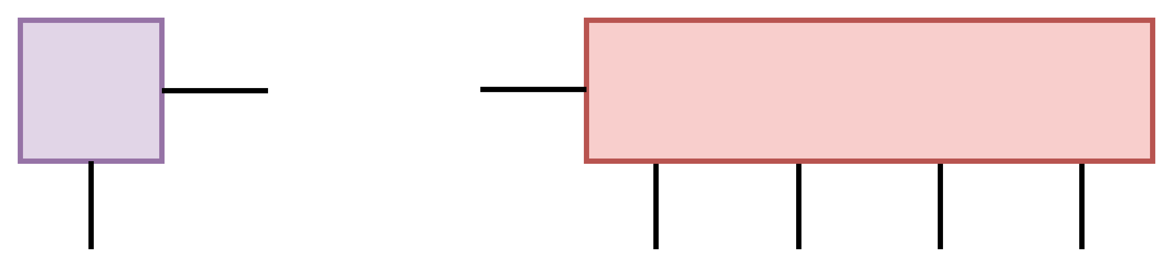
Decomposition procedure
Repeatedly find quasi-optimal (i_{k}, j_{k}) via sampling
Rows (‘i’)
Columns (‘j’)

Slide 9
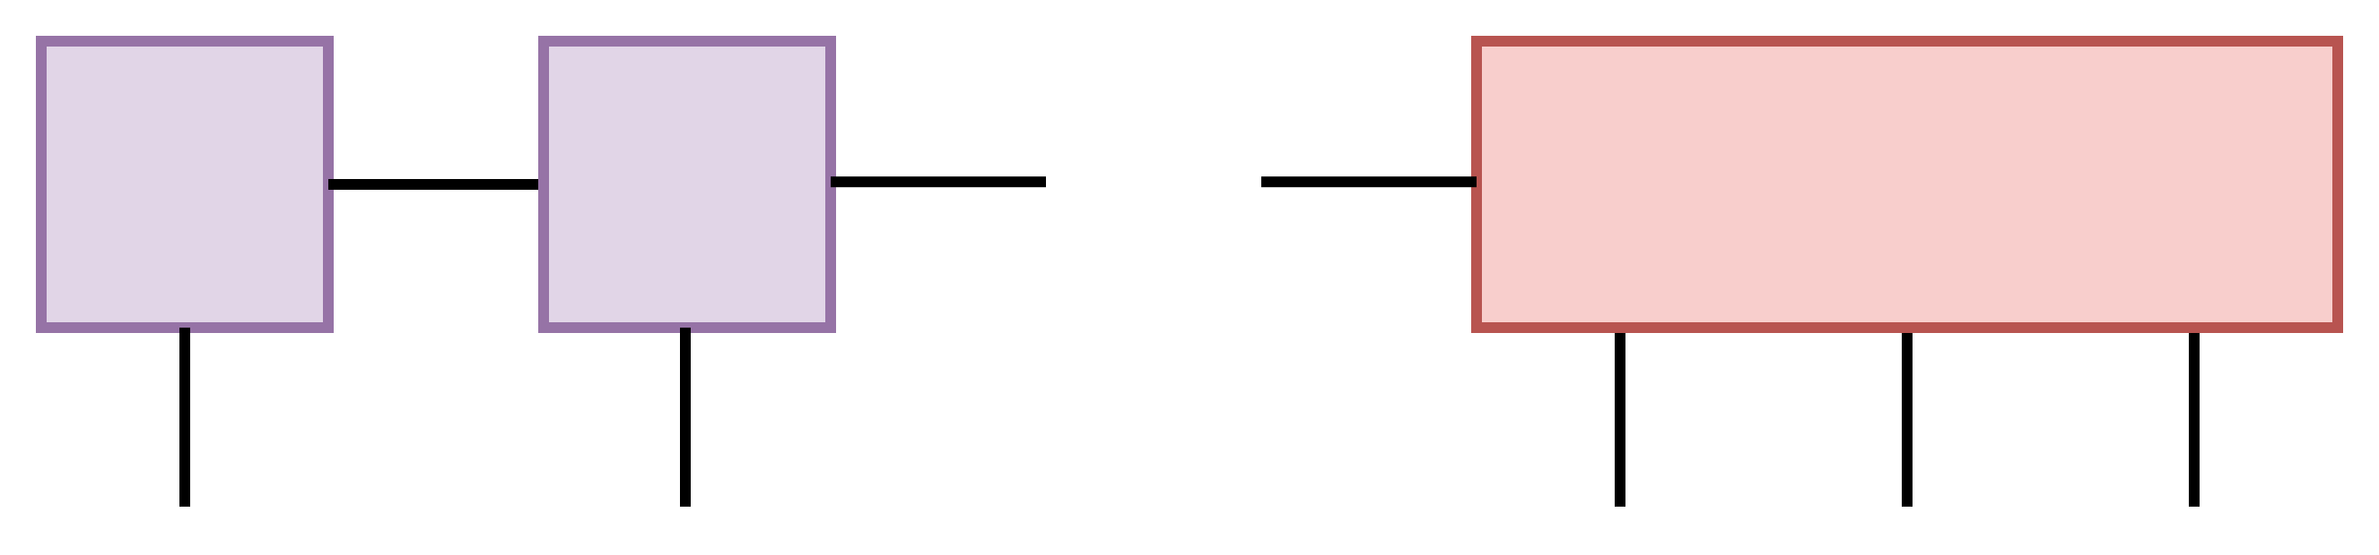

Decomposition procedure

Slide 10
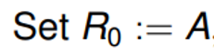
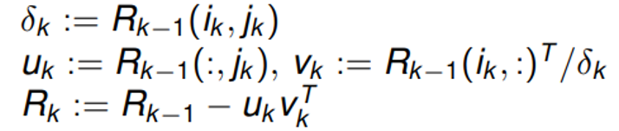
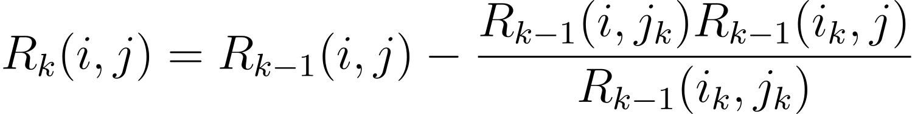
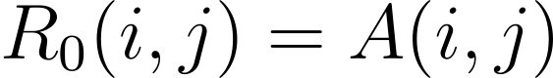
How to compute residual
Naïve recursive function:
Runtime is O(3^{r})!
Runtime improved to O(r³) via memoization/dynamic programming

Slide 11
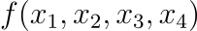
Outcome of TT-cross
2D case:
4-variable function:
Interpolation via sequence of matrix products

Slide 12
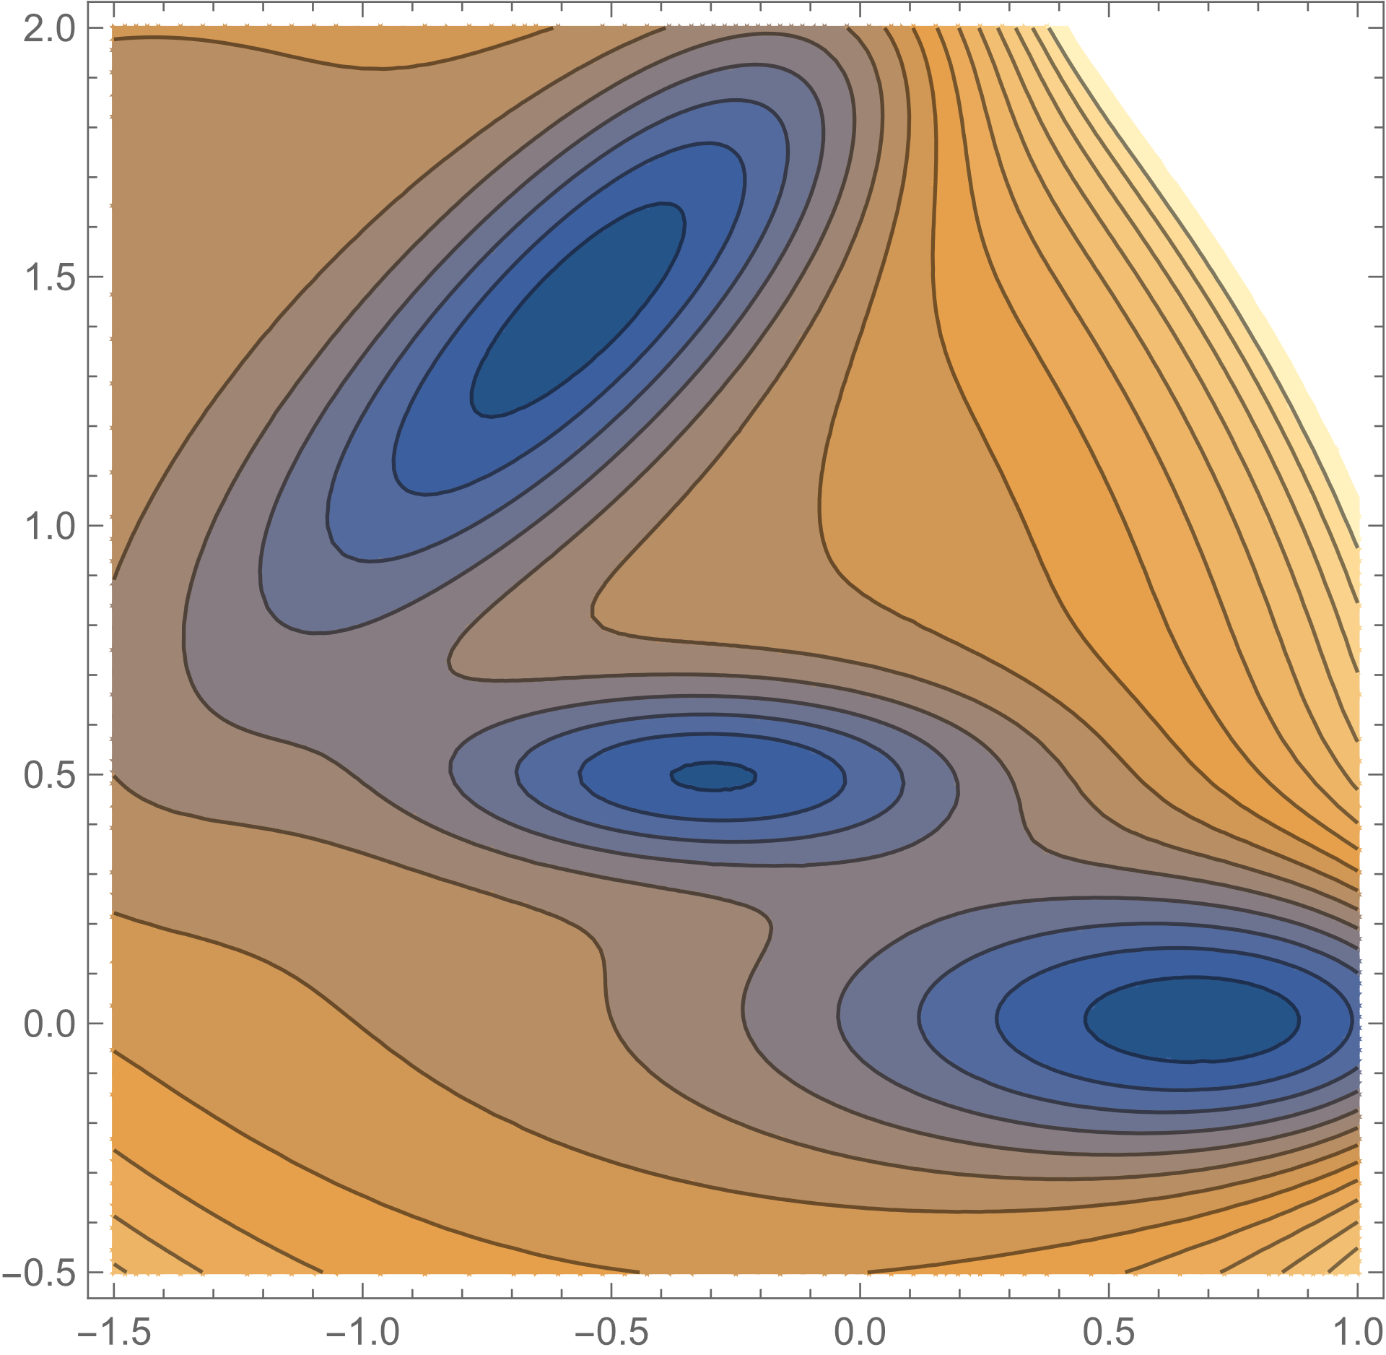
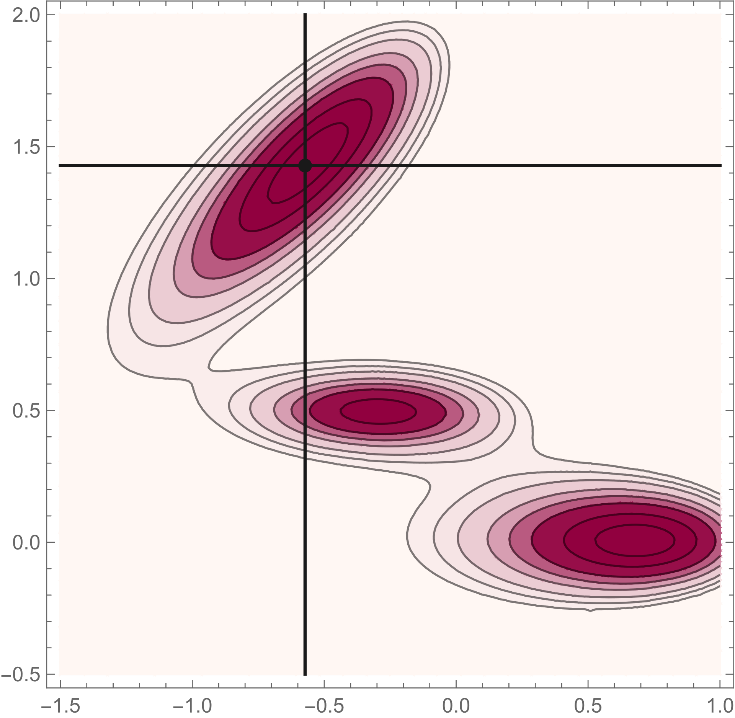
Test case: 2D Muller-Brown potential (r=1)

Slide 13
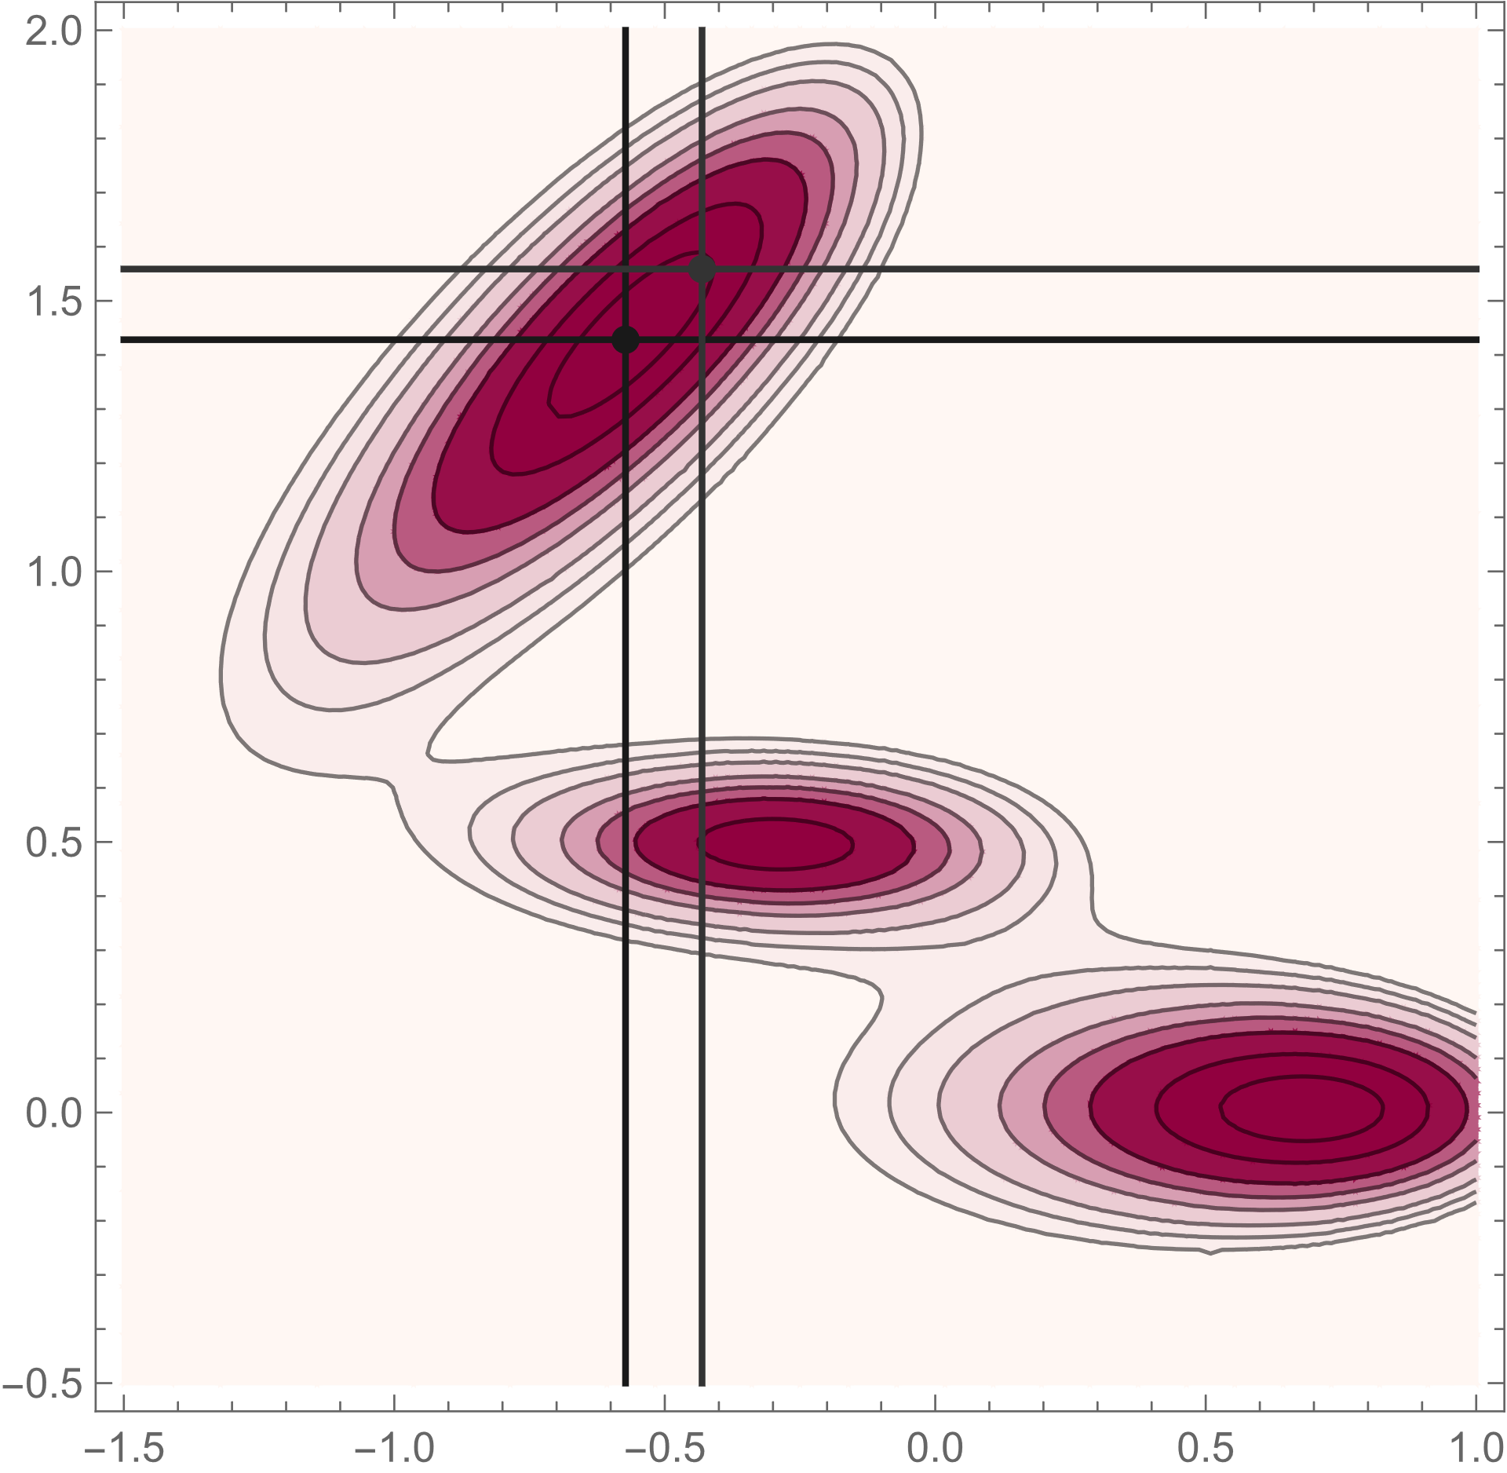
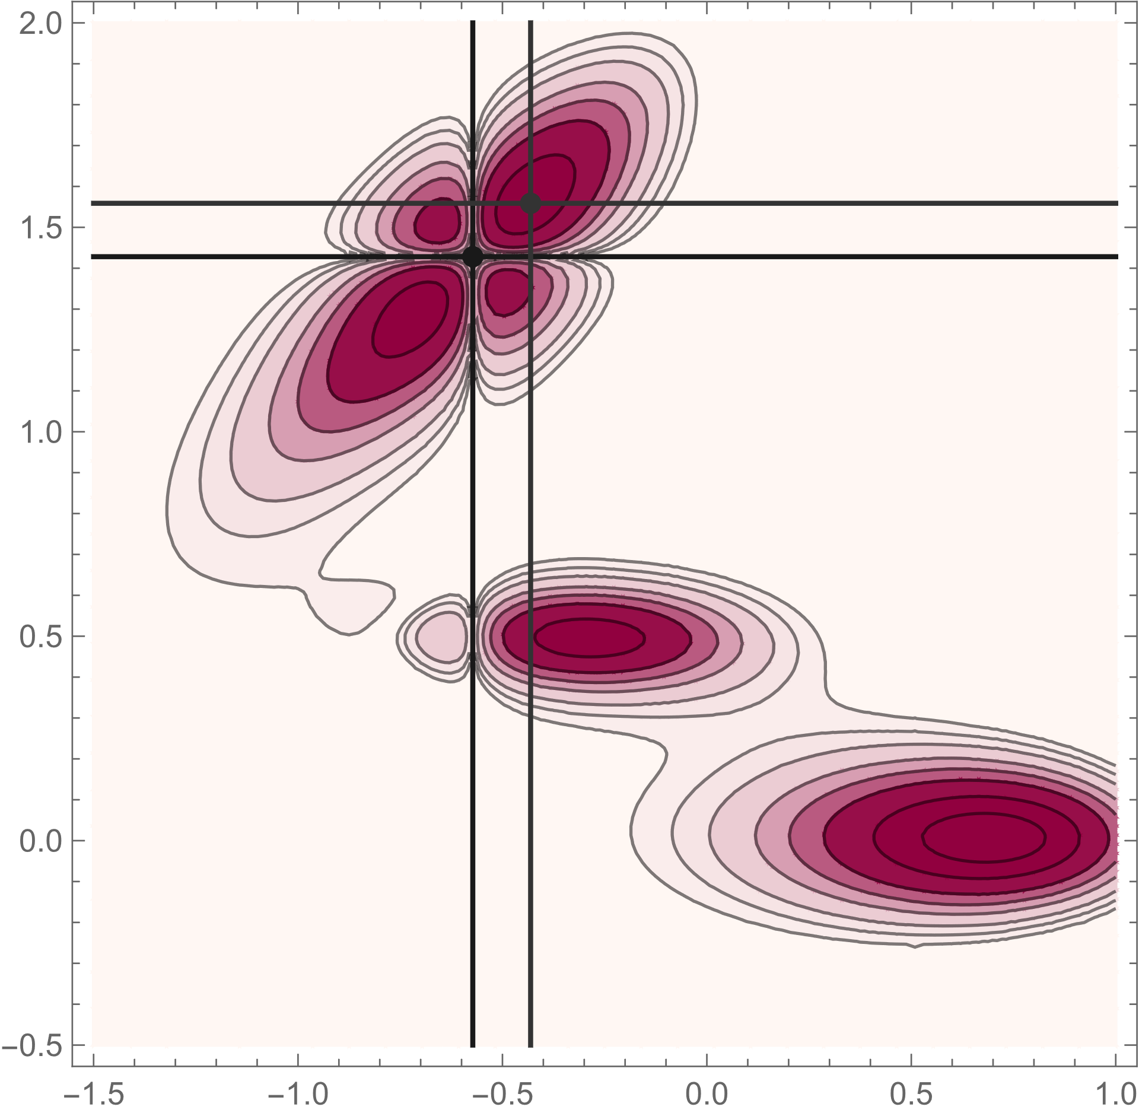
Test case: 2D Muller-Brown potential (r=2)

Slide 14

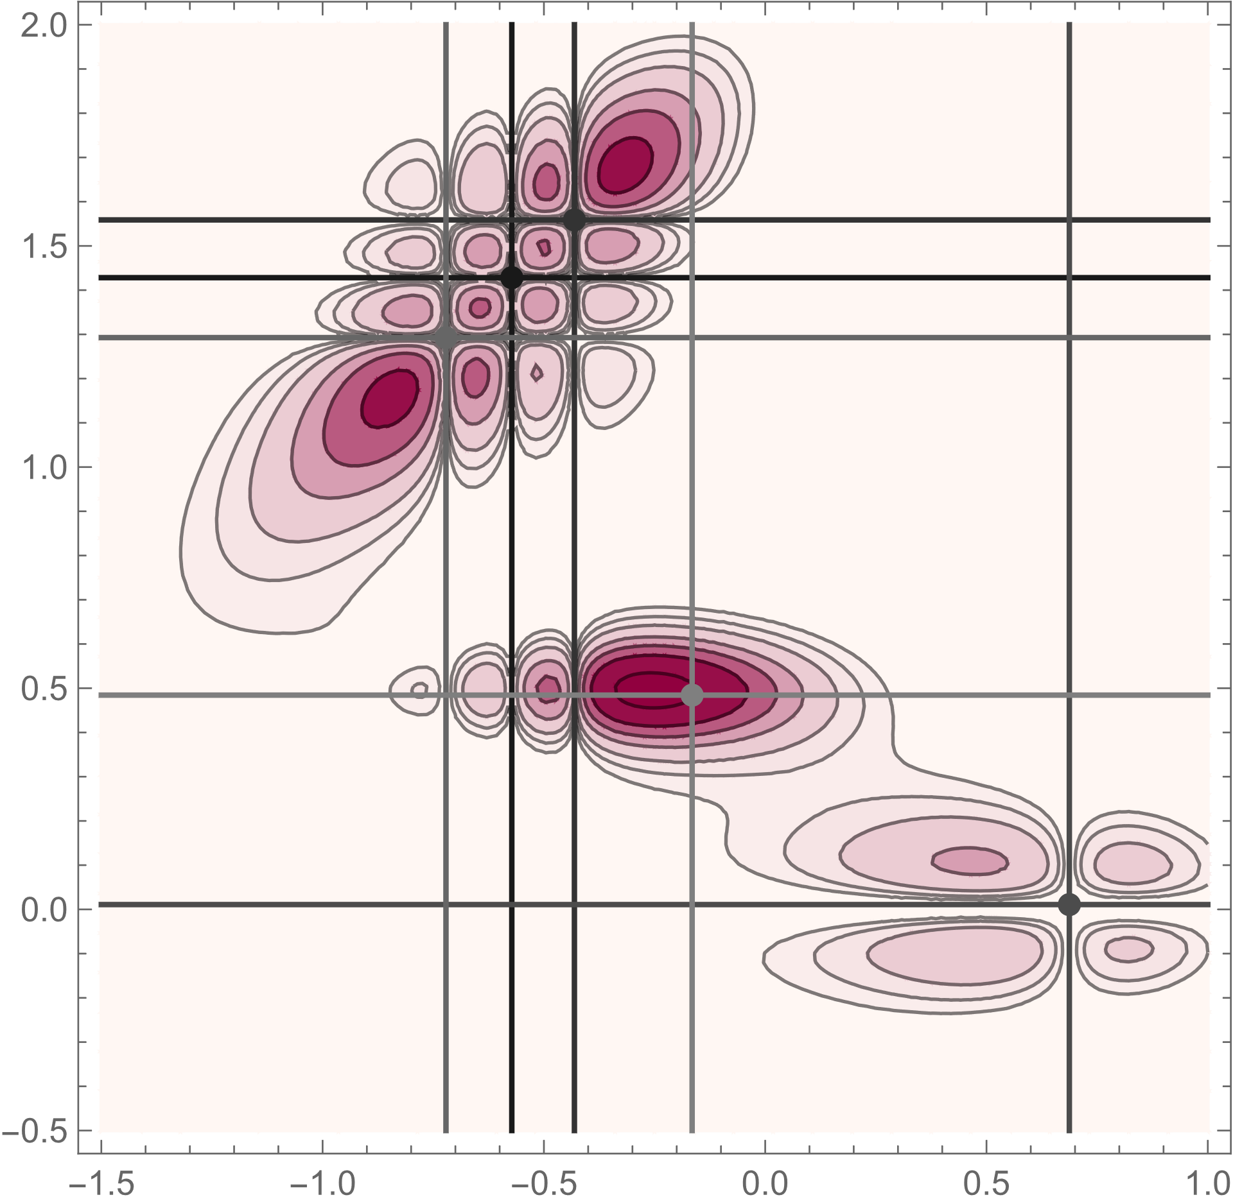
Test case: 2D Muller-Brown potential (r=5)

Slide 15
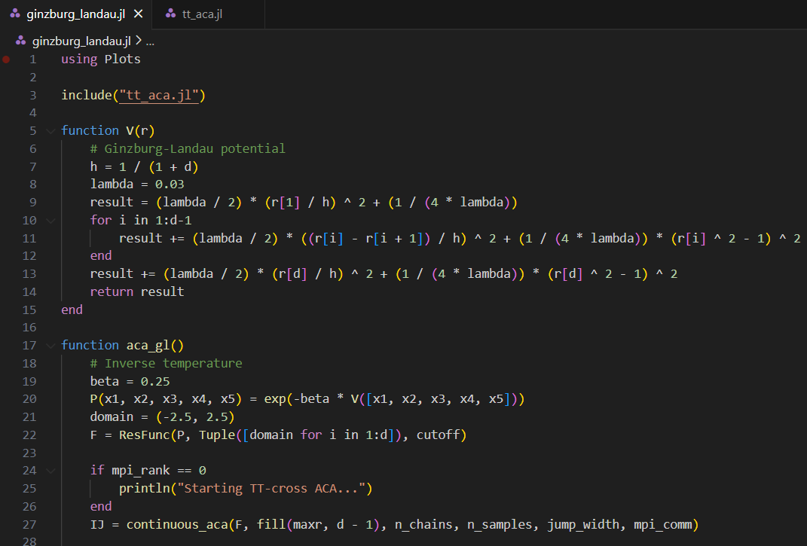
Sample TT-Cross (ACA) code

Slide 16
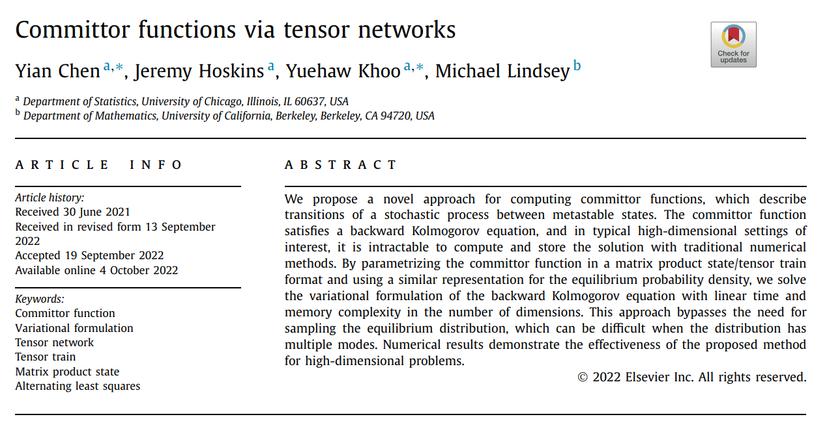

Slide 17

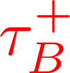
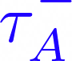
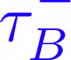
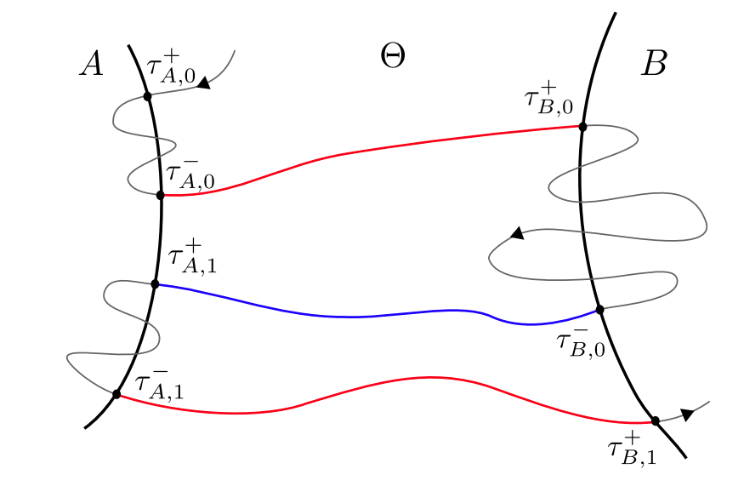
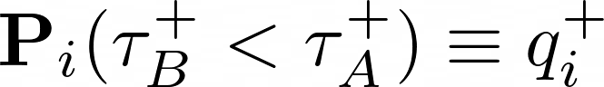
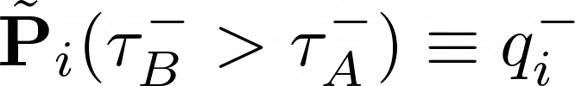
Transition path theory
Transitions from A to B are rare events
First entrance times
Last exit times
Probability distribution of reactive trajectories
“Forward committor”
“Backward committor”
P. Metzner et al. 2009 Multicale Model. Simul. 7 1192—1219

Slide 18
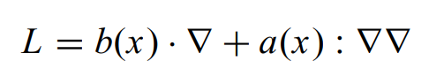
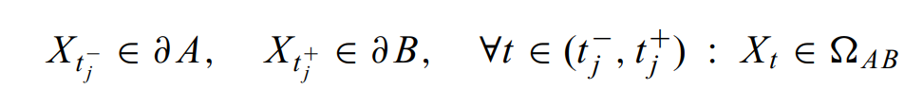
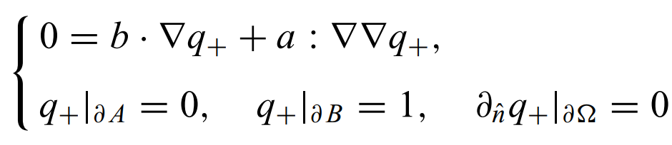
Transition path theory
Generator of diffusion process
Forward committor
Backward committor
Forward committor satisfies backward Kolmogorov equation
E. Vanden-Eijnden and Weinan E. 2006 J. Stat. Phys. 123 503—523

Slide 19
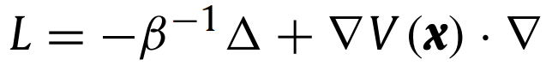
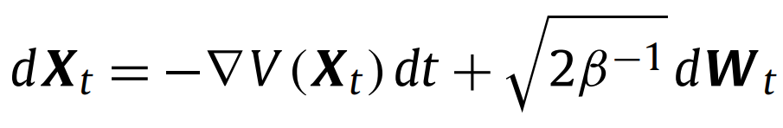
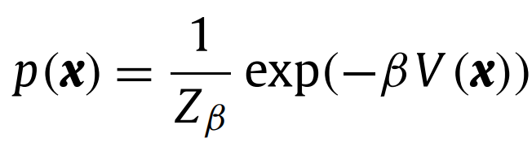
Transition path theory
Generator of diffusion process
“Force”
Underlying overdamped Langevin process: samples Boltzmann distribution!
Backward Kolmogorov equation
Y. Chen et al. 2022 J. Comput. Phys. 472 111646

Slide 20
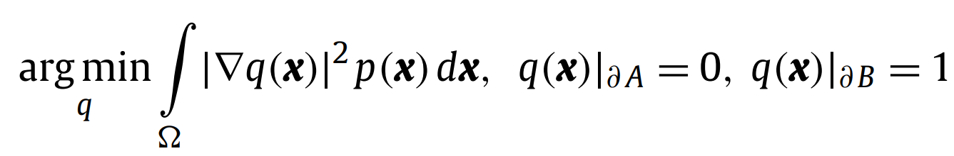
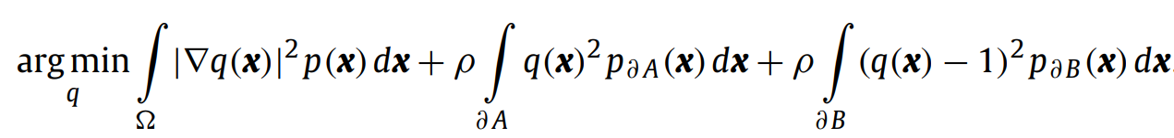
Variational formalism for committor
Add penalty terms to account for boundary conditions:
Probability measures supported on boundaries of A and B
Euler-Lagrange equation
Y. Chen et al. 2022 J. Comput. Phys. 472 111646

Slide 21
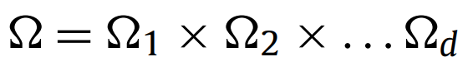
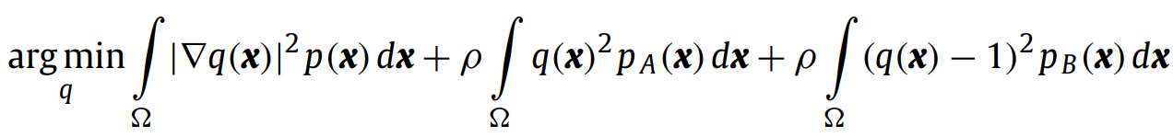
Soft committor
Issue: surface measures on boundaries of A and B are not representable with functions on Ω (i.e., tensor decompositions)
Modified variational problem: soft boundary conditions in the definition of the committor
(state space augmented with “cemetery states” c_{A} and c_{B})
Probability densities p_{A} and p_{B} are now absolutely continuous with respect to the Lebesgue measure on Ω
Y. Chen et al. 2022 J. Comput. Phys. 472 111646

Slide 22
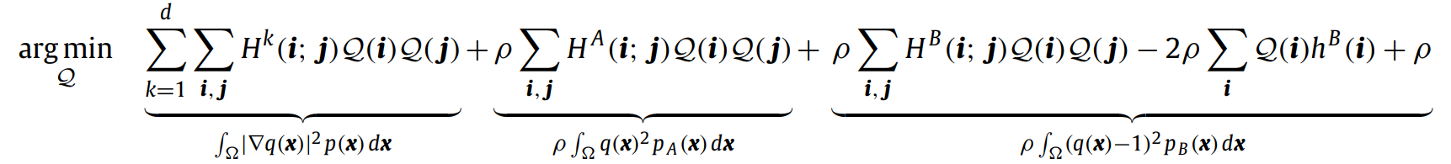
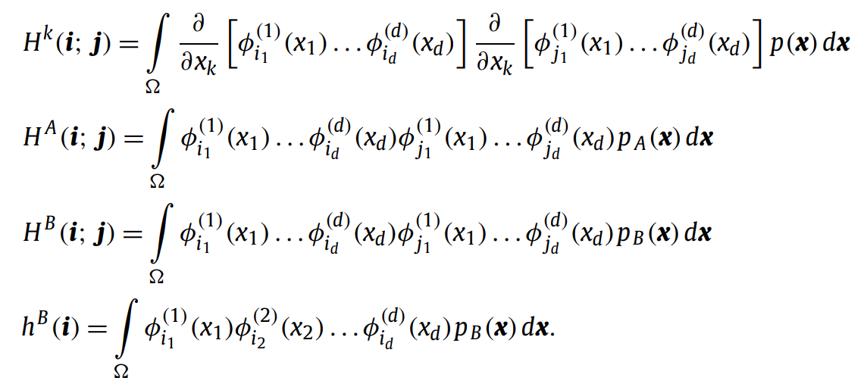
Tensor network-based variational problem
Y. Chen et al. 2022 J. Comput. Phys. 472 111646

Slide 23




Tensor network-based variational problem
This assumes p is already accurately represented as a TT!
Matrix product operator (MPO)
Y. Chen et al. 2022 J. Comput. Phys. 472 111646

Slide 24


Tensor network-based variational problem
A and B are spheres
Use similar procedure for building MPO as in previous slide!
Rank = 1 if p_{A} and p_{B} are multivariate Gaussians
Y. Chen et al. 2022 J. Comput. Phys. 472 111646

Slide 25


Tensor network-based variational problem
Y. Chen et al. 2022 J. Comput. Phys. 472 111646

Slide 26


Tensor network-based variational problem
Y. Chen et al. 2022 J. Comput. Phys. 472 111646

Slide 27



Tensor network-based variational problem
Cores optimized via alternating least squares
Y. Chen et al. 2022 J. Comput. Phys. 472 111646

Slide 28



Some TT-committor results
d = 20
T = 0.2
T = 0.05
Y. Chen et al. 2022 J. Comput. Phys. 472 111646

